Slide 1
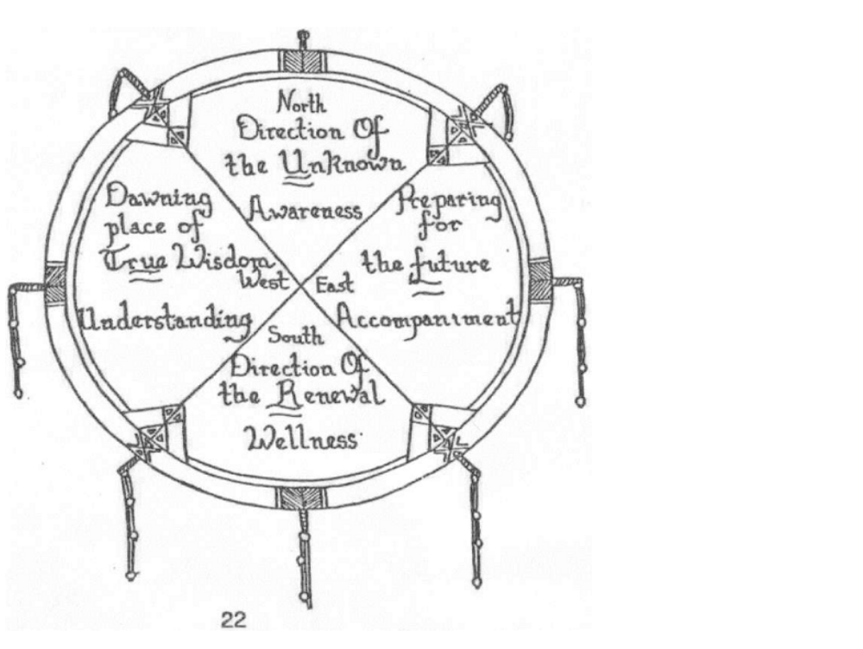
Psychiatric nursing framework
Notes:
how the medicine wheel fits in with psychiatric nurses view of wholistic health

Slide 2
Wholistic Health Wheel
For psychiatric nurses
Psychiatric Nursing Wholistic Health wheel

Slide 3
Wholistic health
Health is viewed in wholistic terms.
The term “wholistic health” is adopted from a Philosophy to Health Care (Regina Qu’Appelle Health Region, 2008) by Saskatchewan First Nations and Metis Health office which acknowledges that health includes a number of interconnected components.

Slide 4
Wholistic Health
These beliefs of health are congruent with the beliefs of the Psychiatric Nursing program faculty and staff. Health is viewed as a combination of the interrelated parts, with the different parts individually considered. (Psychiatric Nursing Program Student handbook).

Slide 5
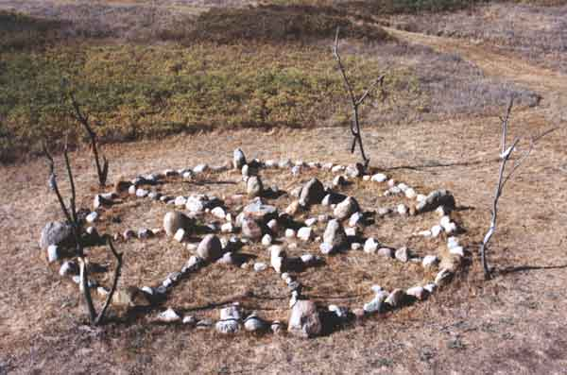
Wholistic Health Wheel
Based on the First Nation’s Medicine Wheel representing harmony
It is considered a major symbol of peaceful interaction.

Slide 6
The Mystery of the Medicine Wheel
Despite their physical existence, there is a lot
of mystery that surrounds the medicine wheel as no written records to their purpose has been found.
Two theories exist
A. The wheels contain significant stellar and cosmological alignments

Slide 7
The Second Theory
B. The medicine wheel was used in the performance of specific rituals and ceremonies.
Medicine wheels are still used today in many Indigenous ceremonies and teachings.
There are approximately 370 million Indigenous people in the world, belonging to 5,000 different groups, in 90 countries worldwide.

Slide 8
Archeologists and the Medicine Wheel
Erecting massive stone structures is a
well-documented activity of ancient man,
from the Egyptian Pyramids to Stonehenge,
and the First Nation’s tribes of North America.
What separates the Medicine Wheel structure from the others is that the stones have been laid down on the earth rather than constructing towering stone monoliths.

Slide 9
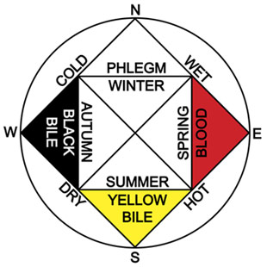
Greek Medicine Wheel
Many traditional healing systems have some type of medicine wheel teaching

Slide 10
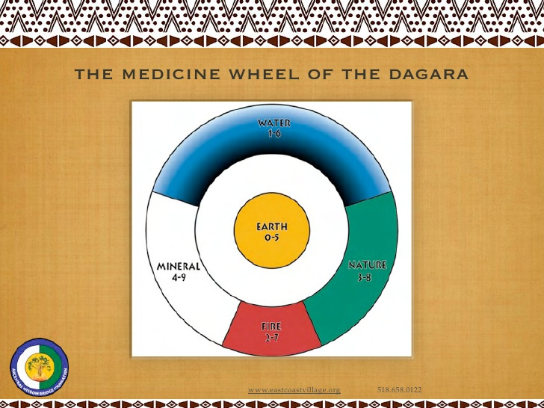
Notes:
https://www.cs.mcgill.ca/~rwest/link-suggestion/wpcd_2008-09_augmented/wp/l/List_of_indigenous_peoples.htm

Slide 11
African Medicine Wheel of the Dagara
https://www.slideshare.net/aamirah/east-coast-village-outreach
A small country made of sixty tribes speaking as many languages.
The region lies within the Sudanic vegetation belt of the West African savannah called Burkina Faso
The Dagara people live in community.
http://www.sobonfu.com/articles/writings-by-sobonfu-2/the-dagara/

Slide 12
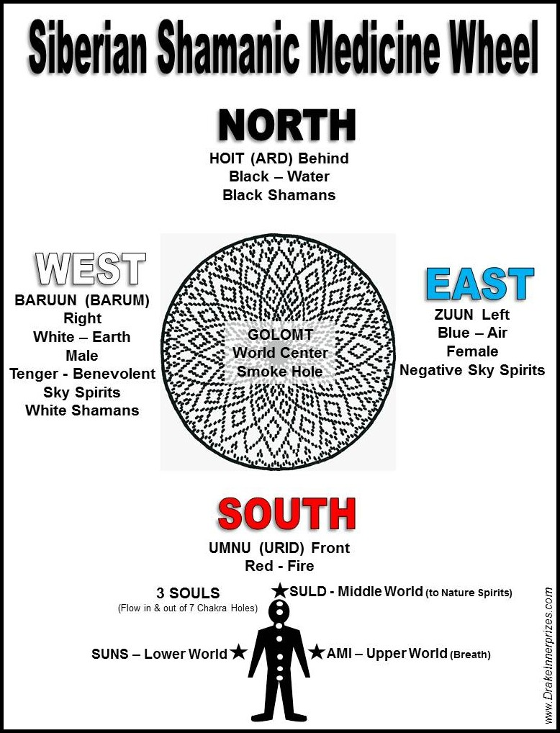

Slide 13
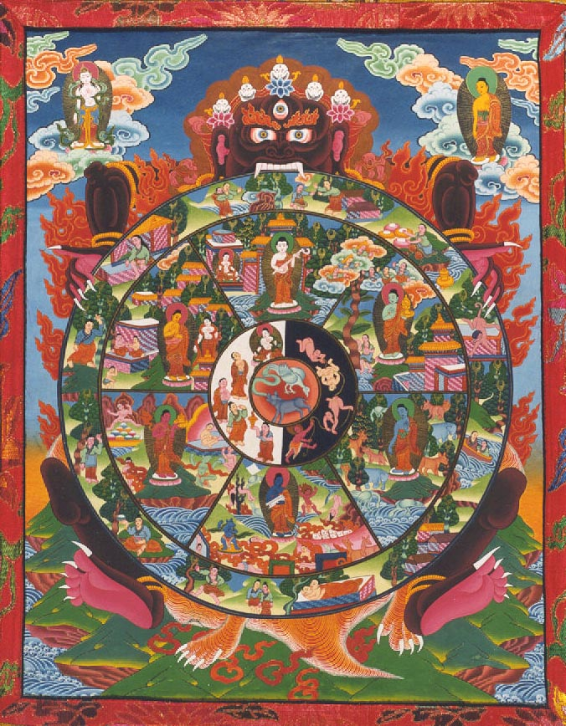
Tibetan Wheel of Life http://www.webpages.uidaho.edu/~rfrey/116bhavacakra-large.htm

Slide 14
Concepts of the Wholistic Health Wheel in
Psychiatric Nursing (based on the Medicine Wheel)
East
To reflect upon the role of the psychiatric nurse within the collaborative healing relationship
South
To describe central beliefs related to wellness that influences traditional people, including First Nations
West
Increase awareness and understanding of the meaning of healing
North
To seek self-awareness through examining the First Nations’ and other traditional practices

Slide 15
Wholistic Health
Incorporates the, mental, emotional, physical and spiritual needs
Needs can be addressed individually, but all aspects must be considered

Slide 16
Four Dimensions of Wholistic Health
Requires us to examine:
The 4 dimensions
Mental Dimension
Emotional Dimension
Physical Dimension
Spiritual Dimension
Notes:
-

Slide 17
Mental Self
Mental Dimension (not be confused with mental health)
Awareness of self-concept, relationships with others. Self awareness
Cognitive capacity and potential. Critical thinking and problem solving
Developed by taking in and interpreting our environment - fact and feelings.

Slide 18
Mental Perspective
One aspect is looking at different learning styles
Fleming VARK Model
1 Visual
2 Auditory
3 Reading/writing
4 Kinesthetic or tactile learners

Slide 19
Emotional self
Emotional dimension
Awareness of responses, feelings, reactions and potential for building meaningful relationships.
Developed by emotionally giving to and receiving from others and establishing supportive networks.
Notes:
-

Slide 20
Physical Self
Physical dimension
Awareness of personal and general physiology, body image and physical potential. Developed by adequate nutrition, exercise, rest and stress management.
Notes:
-

Slide 21
Spiritual Self
Spiritual dimension
Awareness of meaning, potential for moral courage, and contribution to society, vitality and personal energy. Developed by reading, meditation, prayer, and spending time with nature.

Slide 22
Traditional health practices
Family traditions
Cultural traditions
Current traditions
Table group exercise in small groups

